Slide 1

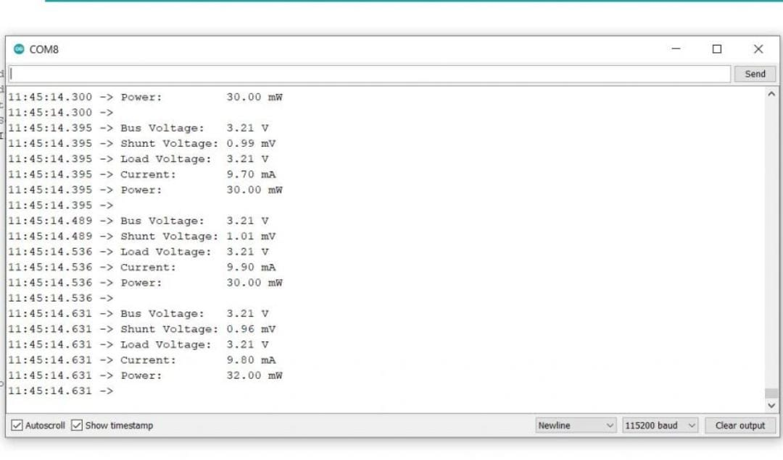
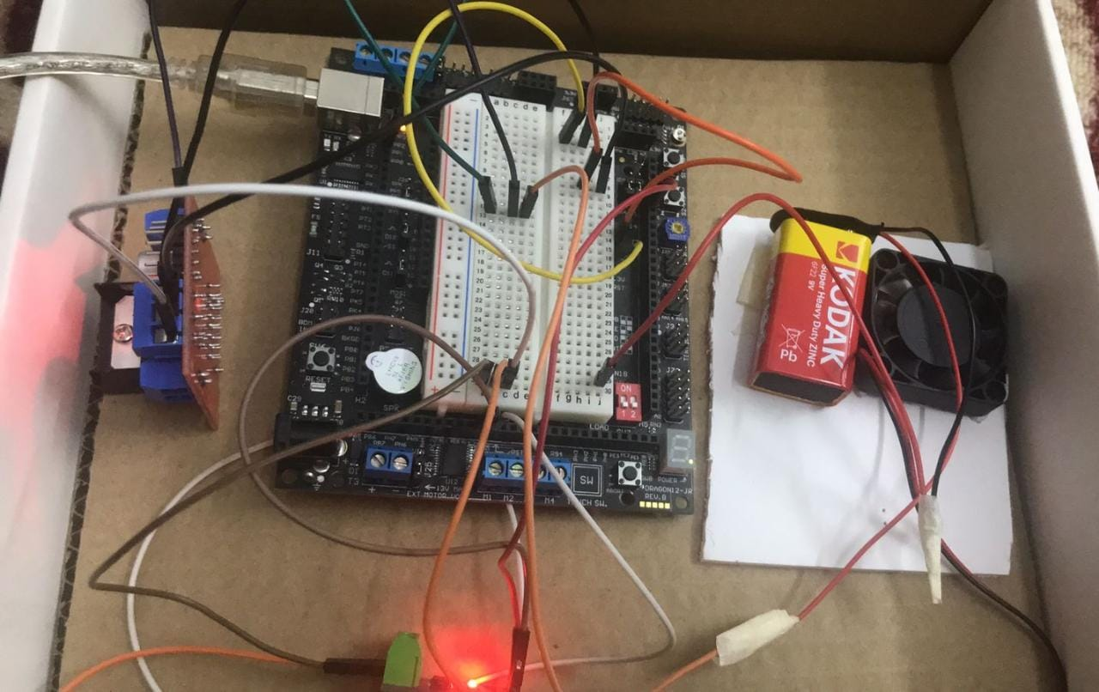
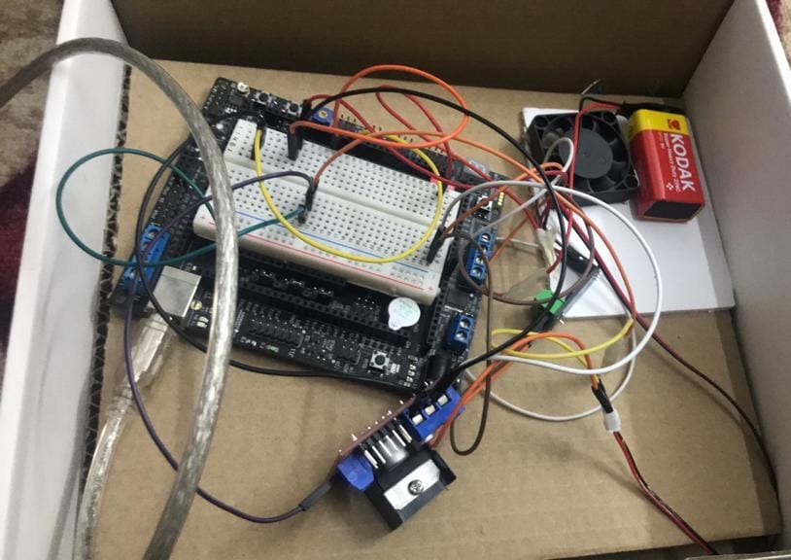
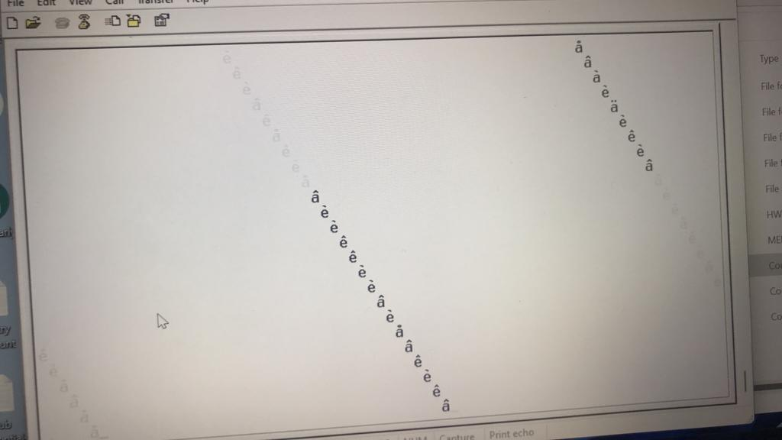
HCS12-based power meter and fan speed controlled by Temperature using PWM technique
Fatema ALI, Shatha Alhamad
Supervisor: Dr. Belal Sababha
Embedded Systems Design Final Design Project, Spring 2023
King Abdullah II School of Engineering
Princess Sumaya University for Technology
Introduction
With the increasing demand for energy efficiency and environmental sustainability, there is a growing need for advanced control systems that can monitor and regulate power consumption in various applications. In this context, the integration of microcontrollers has proven to be highly effective, offering a versatile and powerful solution for controlling and monitoring devices. This paper presents a design and implementation of a power meter and fan speed control system based on the HCS12 microcontroller, incorporating temperature regulation using the pulse width modulation (PWM) technique. Furthermore, the system enables data transfer to a personal computer (PC) via serial communication.
By leveraging the capabilities of the HCS12 microcontroller, this project aims to contribute to energy efficiency goals and provide a scalable platform for implementing intelligent power management systems in various settings, including residential, commercial, and industrial environments
Results
the expected results
.
Our results
Design
Figure 1.System Design
.
Components: -
Microcontroller: HCS12
temperature sensor) build in HCS12)
Current sensor ACS712
Serial Cable
Battery DC
Load (fan)
H-Bridge
Wires
Implementation Process: -
Making sure that the HCS12 can measure the voltage of the system.
Measuring current from a system.
Build a code that computes the power and energy consumed.
Applying the dynamic pricing concept and bill calculation. .
Display the information on PC screen.
Develop the loads
Calibrate the system and compare it to other products.
The expected work in the future regarding the prototype is adding more than one load. We can see in the video that we have only one load which is fan but our plan to have more than one and put them in a designed box to make it look organized
Conclusion
The HCS12 microcontroller-based power meter and fan speed control system with temperature regulation using PWM technique and serial communication to a PC offers a comprehensive solution for energy management. Its accuracy, responsiveness, and versatility make it suitable for a wide range of applications in residential, commercial, and industrial settings. By providing real-time power monitoring, intelligent fan speed control, and data transfer capabilities, the system contributes to energy efficiency goals and enables users to make informed decisions for sustainable energy consumption

